Slide 1

FULL PAPER PRESENTATION
Enhancing Student
Engagement Using
Generative AI Tools
in Online Learning Environments
Tanvir Ahmed • Brishty Das • Fahima Islam • Dr. Afroza Nahar
Department of Computer Science
American International University-Bangladesh
6th International Conference on Educational Technology and Online Learning — ICETOL 2026
ICETOL 2026 • Generative AI & Student Engagement

Slide 2
CONTEXT
Why this study matters
02
THE CHALLENGE
CORE IDEA
Online learning expands access - but engagement can be difficult to sustain.
AI support should be
measured - not assumed.
• Learners can become passive when digital material lacks interaction.
• Motivation and persistence depend on active engagement with content.
• Generative AI introduces a new layer of interaction, feedback, and personalization.
This study compares the same learners under traditional and AI-assisted learning conditions.
ICETOL 2026 • Generative AI & Student Engagement

Slide 3
MOTIVATION
Research gap and framing
03
The study moves beyond general AI opinions by examining three distinct dimensions of engagement.
BEHAVIORAL
EMOTIONAL
COGNITIVE
Participation
Focus • Task completion
Interest
Motivation • Enjoyment
Understanding
Thinking effort • Learning depth
Gap addressed:
a direct within-participant comparison of traditional vs. AI-assisted learning across multiple engagement dimensions.
ICETOL 2026 • Generative AI & Student Engagement

Slide 4
STUDY OBJECTIVE
Aim and research questions
04
Aim
To examine whether generative AI-assisted learning improves student engagement compared with traditional learning.
RQ1
RQ2
RQ3
Does AI-assisted learning improve overall engagement?
Which engagement dimensions improve most?
How is AI perception associated with AI-assisted engagement?
Same learners • Same topic • Two learning conditions
ICETOL 2026 • Generative AI & Student Engagement

Slide 5
METHOD
Within-subject comparative design
05
1
2
3
4
5
Recruit
Traditional
AI-Assisted
Screen
Analyze
Participants
Learning + assessment
Learning + assessment
Attention check
SPSS statistics
Same participants and same instructional topic enable direct paired comparison while reducing between-person variation.
ICETOL 2026 • Generative AI & Student Engagement

Slide 6
SAMPLE
Participants and data screening
06
301
289
262
Initial form responses
Completed study sections
Final valid sample
“Which learning material included AI assistance?”
90.7%
Attention check
Correctly identified Part 2 as AI-assisted
27 responses with incorrect attention-check answers were excluded before statistical analysis.
ICETOL 2026 • Generative AI & Student Engagement

Slide 7
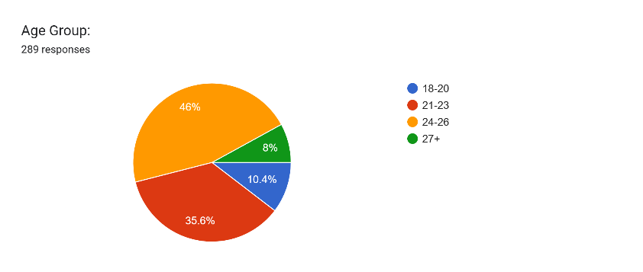
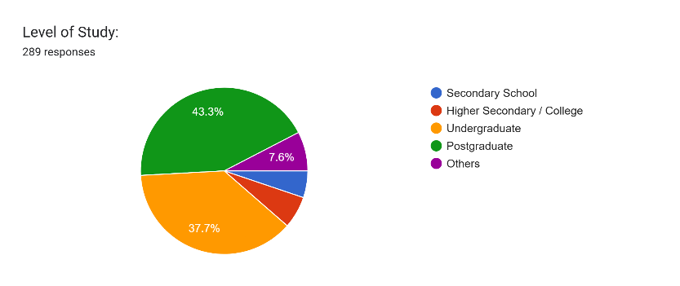
SAMPLE COMPOSITION
Participant profile
07
Age group
Level of study
Largest group: 24–26 years (46.0%)
Largest group: postgraduate students (43.3%)
ICETOL 2026 • Generative AI & Student Engagement

Slide 8
QUESTIONNAIRE
Measurement framework
08
16 analytical items were measured on a 10-point Likert-type scale.
Traditional learning
AI-assisted learning
AI perception
6 items
6 items
4 items
Behavioral • Emotional • Cognitive
Behavioral • Emotional • Cognitive
Engagement • Speed • Interactivity • Over-reliance
Analysis: Cronbach’s α • paired-samples t-tests • Cohen’s d • Pearson correlation
ICETOL 2026 • Generative AI & Student Engagement

Slide 9
RESULTS
Measurement reliability
09
All three constructs demonstrated high internal consistency.
0.915
0.890
0.881
Cronbach’s α
Traditional Learning
Cronbach’s α
AI-Assisted Learning
Cronbach’s α
AI Perception
Descriptive means
Traditional: 6.04 ± 1.36
AI-Assisted: 7.51 ± 1.53
AI Perception: 7.70 ± 1.37
ICETOL 2026 • Generative AI & Student Engagement

Slide 10
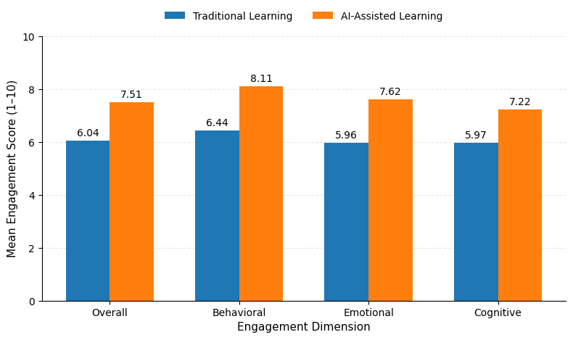
MAIN FINDING
Overall engagement improved
10
+1.46
Overall mean increase
AI minus traditional
p < .001
Paired-samples t-test
d = 0.800
Large effect size
ICETOL 2026 • Generative AI & Student Engagement

Slide 11
RESULTS
Dimension-wise engagement
11
AI-assisted learning significantly improved all three engagement dimensions (p < .001).
Behavioral
Emotional
Cognitive
+1.68
d = 0.819
+1.26
Largest raw increase
Strongest standardized effect
Moderate-to-large effect
Interpretation
AI support influenced participation, motivation, and learning involvement — not only overall engagement.
ICETOL 2026 • Generative AI & Student Engagement

Slide 12
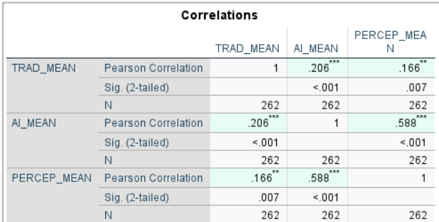
CORRELATION
AI perception and engagement
12
KEY RELATIONSHIP
r = .588
AI perception ↔
AI-assisted engagement
p < .001
A moderate positive association was observed.
Interpretation: correlation indicates association, not causation.
ICETOL 2026 • Generative AI & Student Engagement

Slide 13

INTERPRETATION
What the findings mean
13
Generative AI can make online learning more engaging — when it is integrated as a learning support.
• Support interaction and feedback rather than simply deliver answers.
• Design activities that keep learners cognitively active.
• Treat AI as a complement to human thinking, not a replacement for it.
PRACTICAL TAKEAWAY
AI works best when humans stay actively involved.
ICETOL 2026 • Generative AI & Student Engagement

Slide 14
CLOSING FINDINGS
Conclusion, limitations and future work
14
CONCLUSION
LIMITATIONS
FUTURE WORK
Generative AI-assisted learning significantly enhanced overall student engagement and improved behavioral, emotional, and cognitive engagement.
• Self-reported engagement
• Fixed order of conditions
• Short-term learning context
• Counterbalanced order
• Longer-term experiments
• Objective learning outcomes
The strongest evidence is the large overall effect (d = 0.800) and the consistent improvement across all engagement dimensions.
ICETOL 2026 • Generative AI & Student Engagement

Slide 15
THANK YOU
Questions &
Discussion
Enhancing Student Engagement Using Generative AI Tools in Online Learning Environments
Tanvir Ahmed • Brishty Das • Fahima Islam • Dr. Afroza Nahar
ICETOL 2026
ICETOL 2026 • Generative AI & Student Engagement

